Slide 1
Unit-6

Slide 2
Template Driven Forms
Template-driven forms are a way to create and work with forms in Angular applications where the form's structure and behavior are defined primarily in the component's template (HTML) rather than in the component class.
Here's how template-driven forms typically work:
HTML Template: You define the form structure directly in your component's HTML template using Angular directives like ngModel, ngForm, and others.
Directives: Angular provides a set of directives to facilitate form handling. For example:
ngModel: Used to bind form controls to properties in the component class.
ngForm: Marks the <form> element as an Angular form and provides form-related functionality.
Form Controls: You define form controls (such as inputs, selects, checkboxes) in your HTML template and bind them to properties in your component class using ngModel.

Slide 3
Validation: You can add validation rules directly in the template using attributes like required, minLength, maxLength, etc.
Handling Form Submission: You can handle form submission directly in the template using the (ngSubmit) event, which allows you to call a method in your component class when the form is submitted.
Template-driven forms are generally suitable for simpler forms with straightforward validation requirements. They are easier to set up and require less code compared to reactive forms. However, they might become harder to manage for more complex forms with extensive validation logic.

Slide 4
Basic Example
<form #myForm="ngForm" (ngSubmit)="submitForm(myForm)">
<label for="name">Name:</label>
<input type="text" id="name" name="name" ngModel required>
<label for="email">Email:</label>
<input type="email" id="email" name="email" ngModel required>
<button type="submit">Submit</button>
</form>

Slide 5
In this example, ngModel is used to bind form inputs to properties in the component class, and (ngSubmit) is used to handle form submission. The form will be automatically validated based on the required attribute on the inputs.

Slide 6
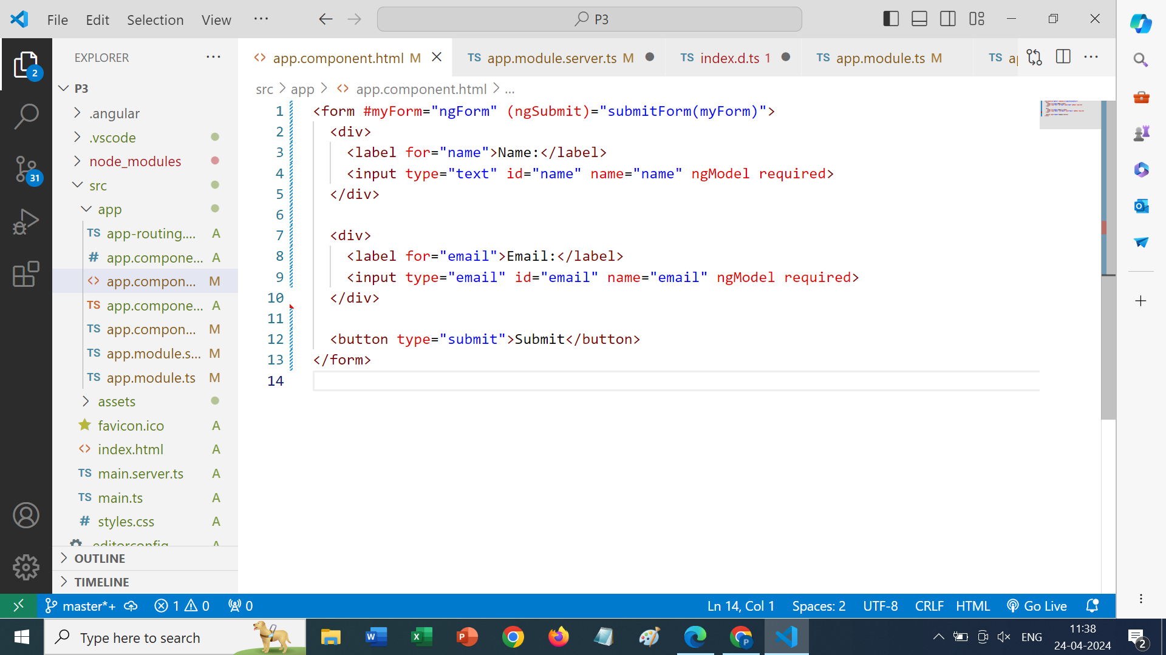
Open app.component.html

Slide 7
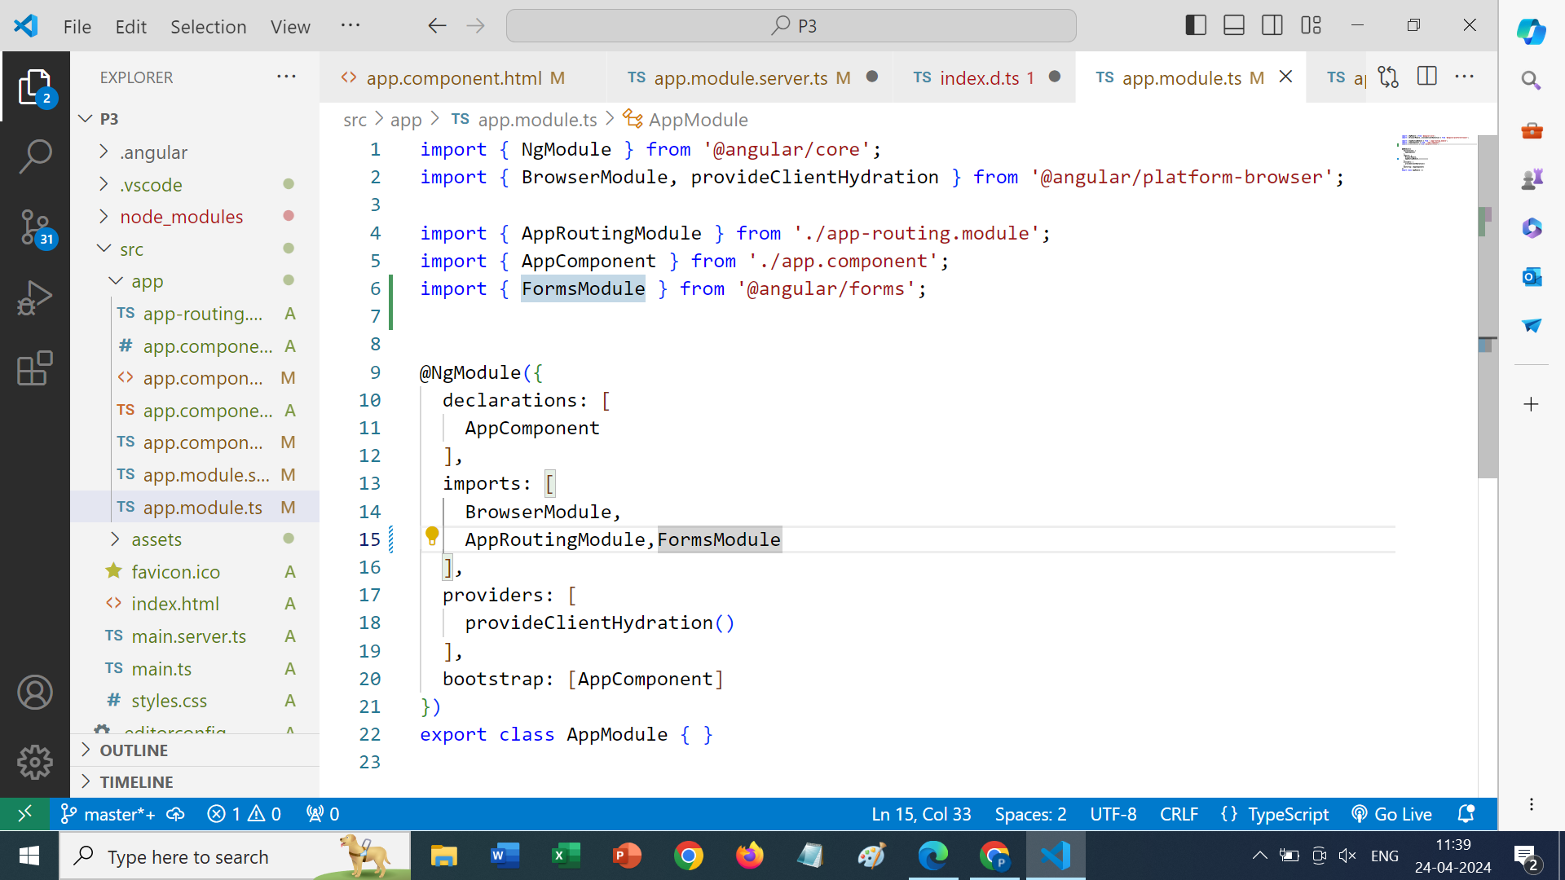
Open app.module.ts(will be created if you are creating standalone project

Slide 8
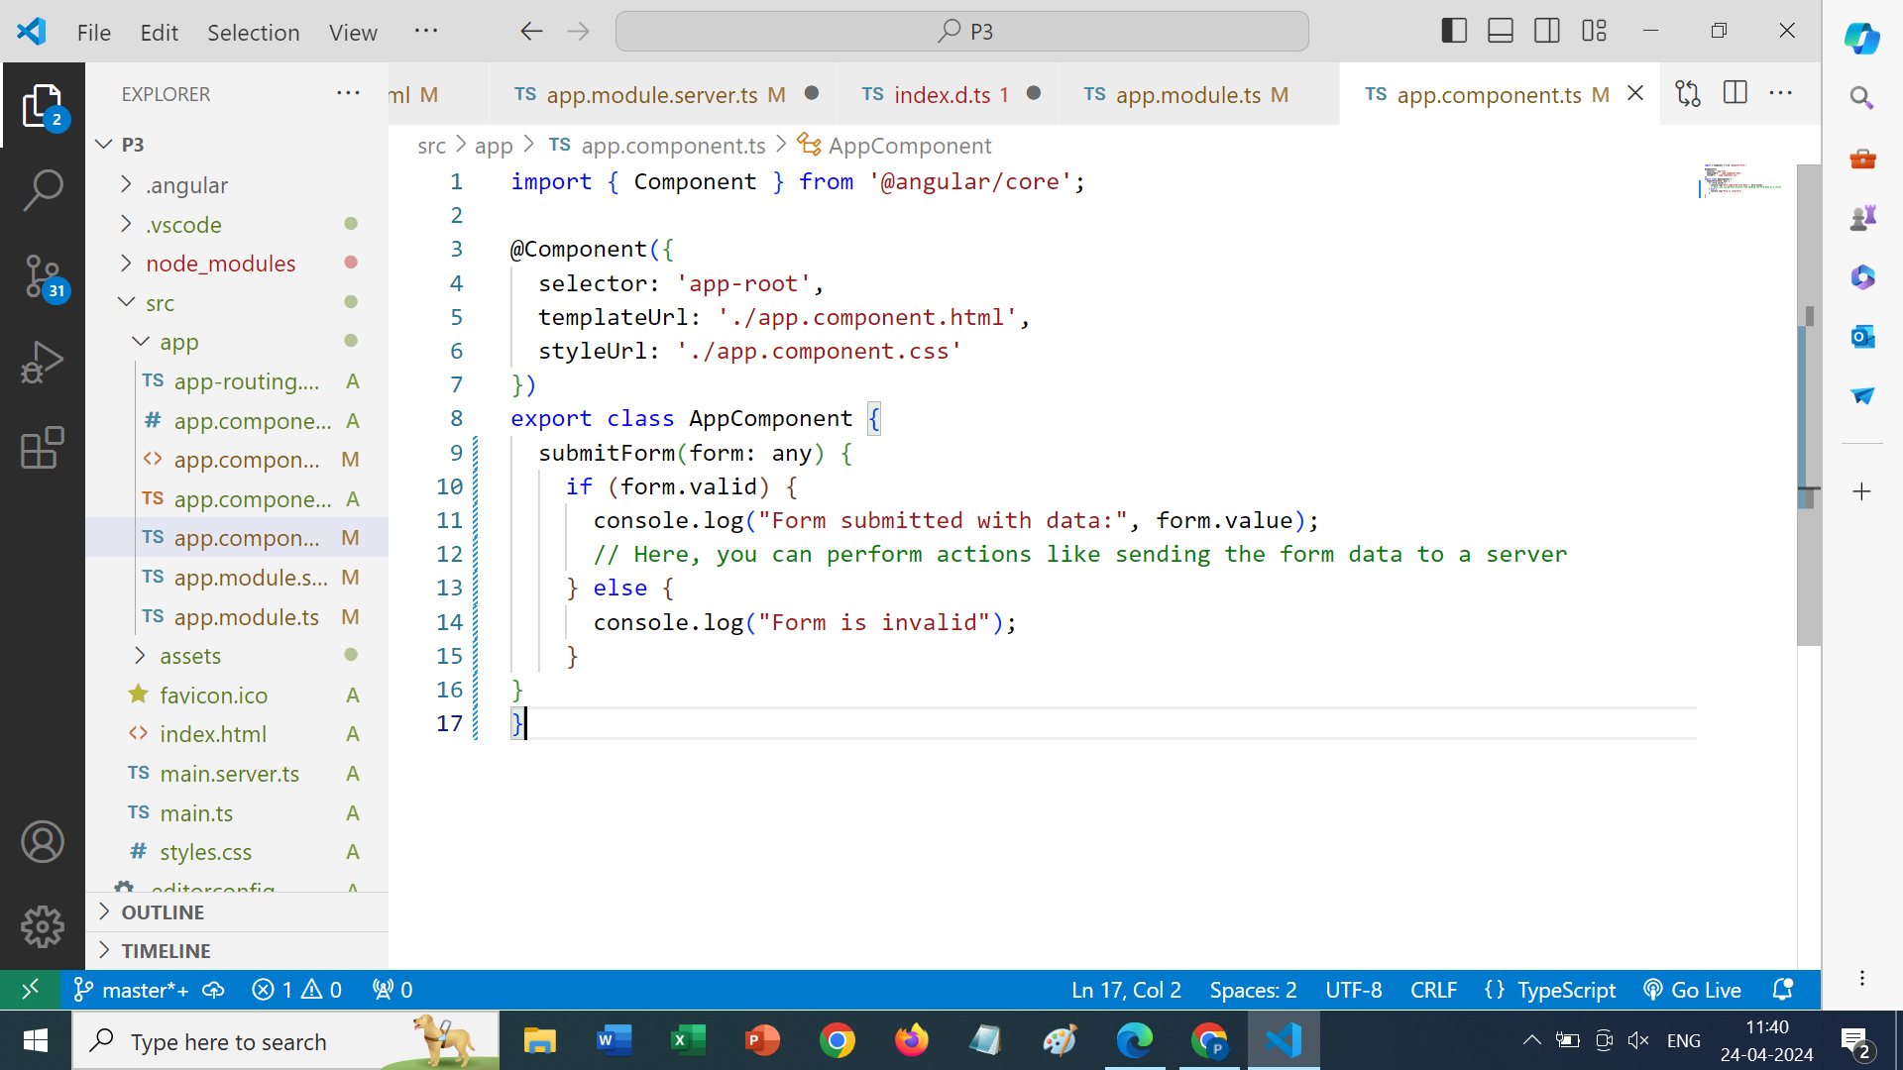
Open app.component.ts

Slide 9
Reactive Forms
Reactive forms are another approach to building forms in Angular applications, offering a more programmatic and flexible way to manage form data and validation logic compared to template-driven forms. In reactive forms:
Form Controls: Form controls are created programmatically in the component class using TypeScript. These controls are instances of classes provided by Angular's @angular/forms module.
FormControl: Each form control represents a single input field in the form. You can define its initial value, validation rules, and event handlers.
FormGroup: A group of form controls can be organized into a FormGroup, which represents a logical grouping of form controls, such as a section of a form.
FormBuilder: Angular provides the FormBuilder service to simplify the process of creating form controls and groups. It offers methods to create FormControl and FormGroup instances with predefined configurations.
Reactive Form Directives: Angular provides directives such as formControlName, formGroupName, and formArrayName to bind form controls and groups to elements in the template.
Dynamic Forms: Reactive forms make it easier to create dynamic forms where the form structure can change based on user interactions or data.

Slide 10
Steps of Creating a Reactive Form
Create one project,let say →
Ng new P6
Create one component inside that lets say -> ng g c one
Open the one.component.ts file

Slide 11
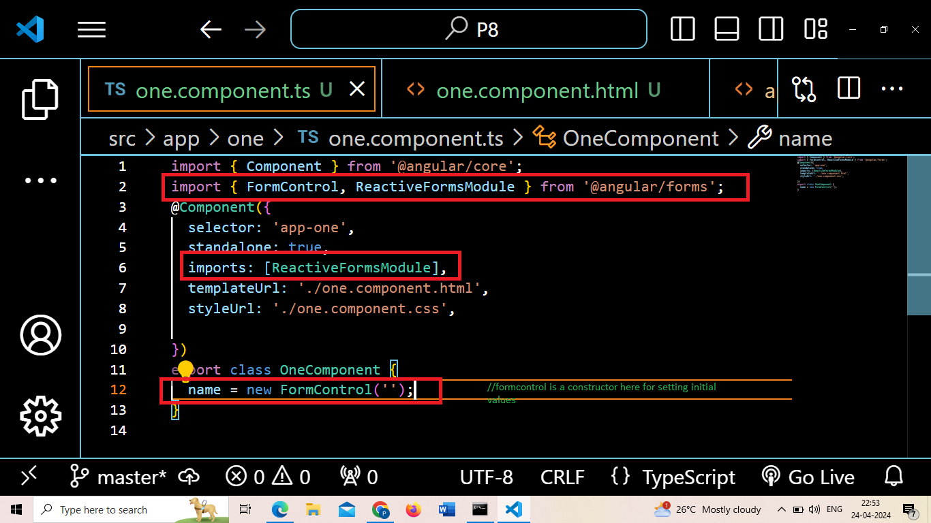

Slide 12
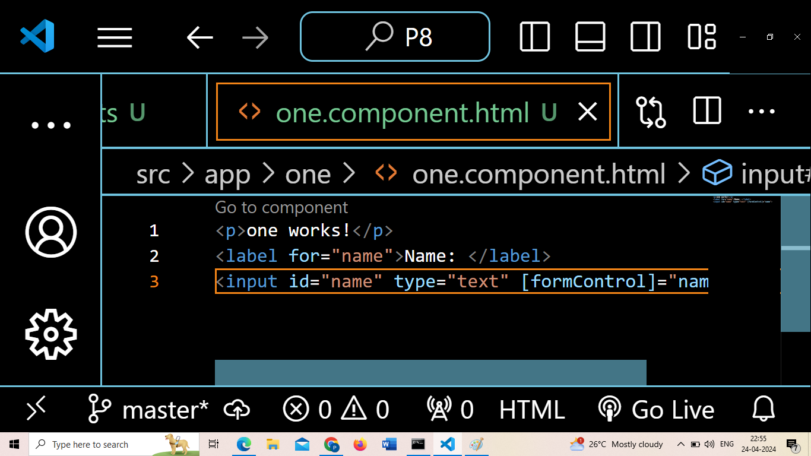
Open one.component.html

Slide 13
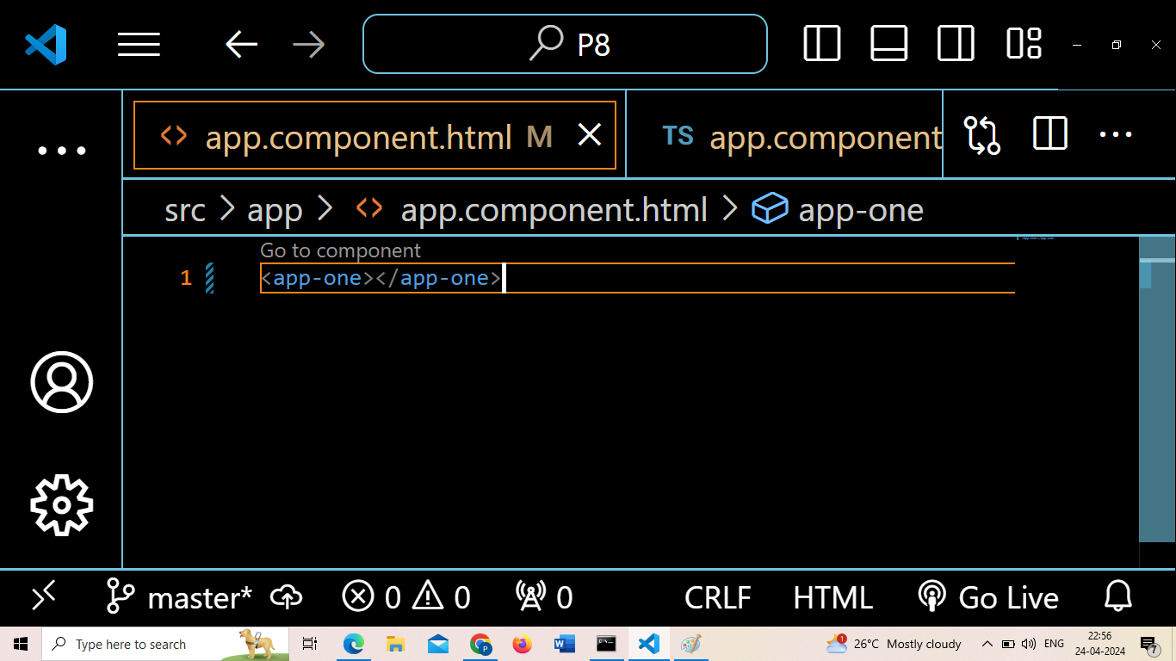

Slide 14
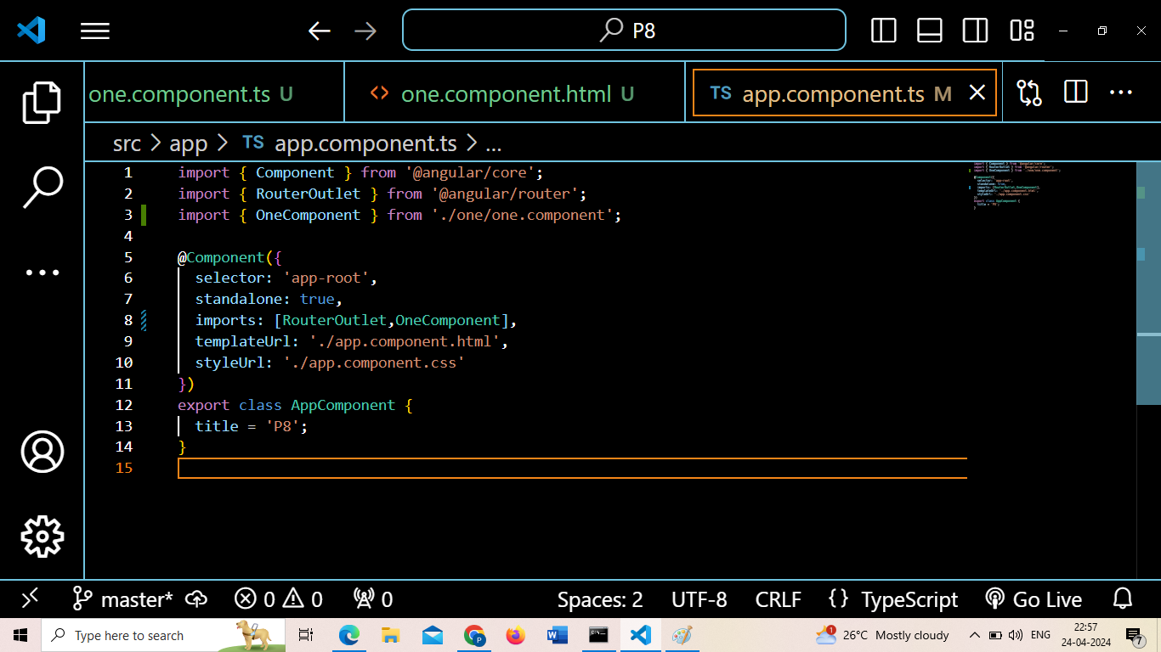
Open app.component.ts

Slide 15
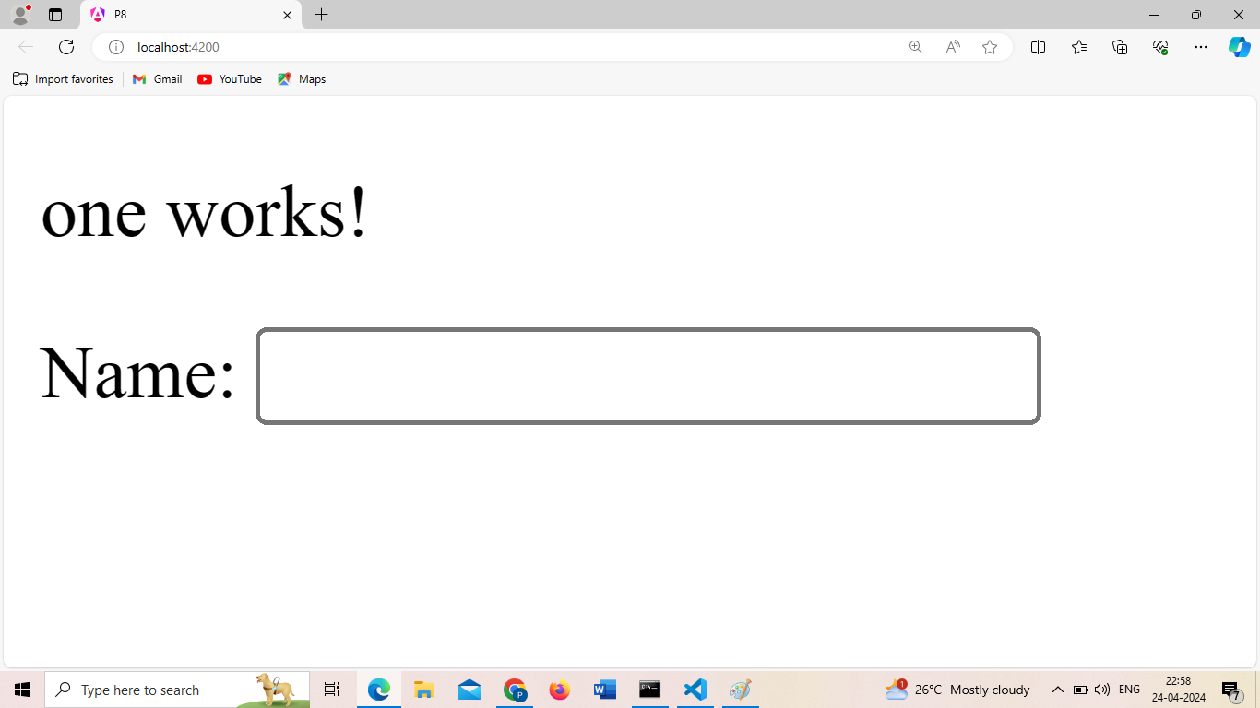
Output

Slide 16
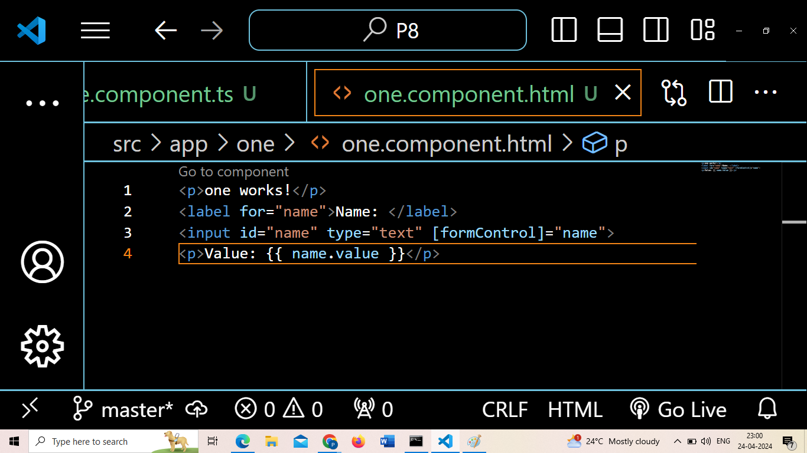

Slide 17
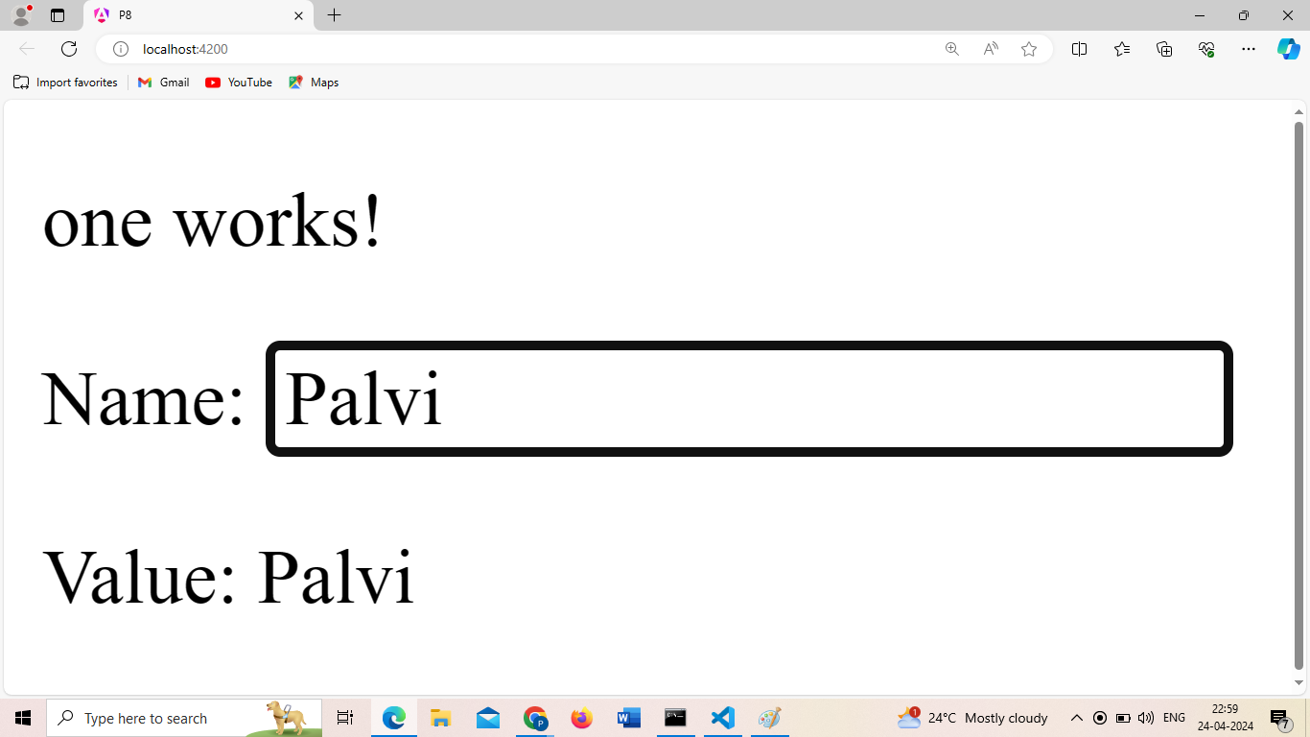

Slide 18
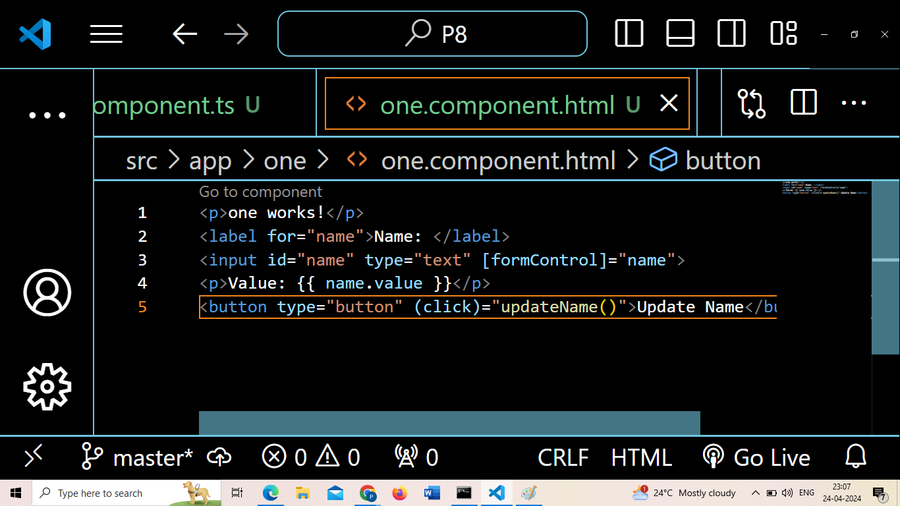
Now, if you want to update a name, add one button

Slide 19
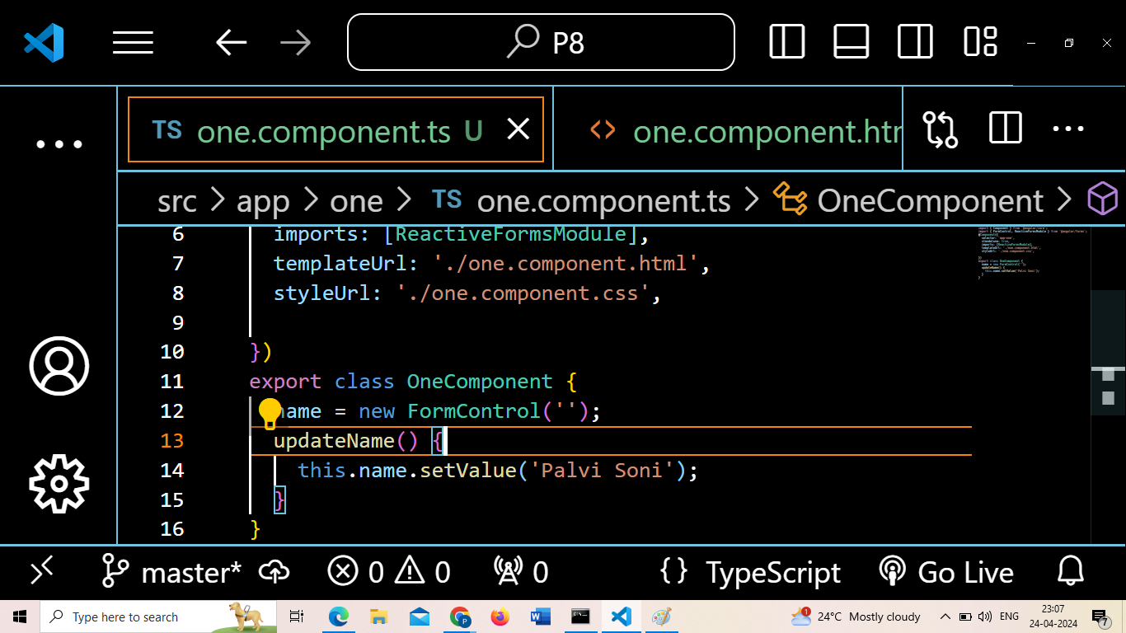
Again in one.component.ts file, make the following changes

Slide 20
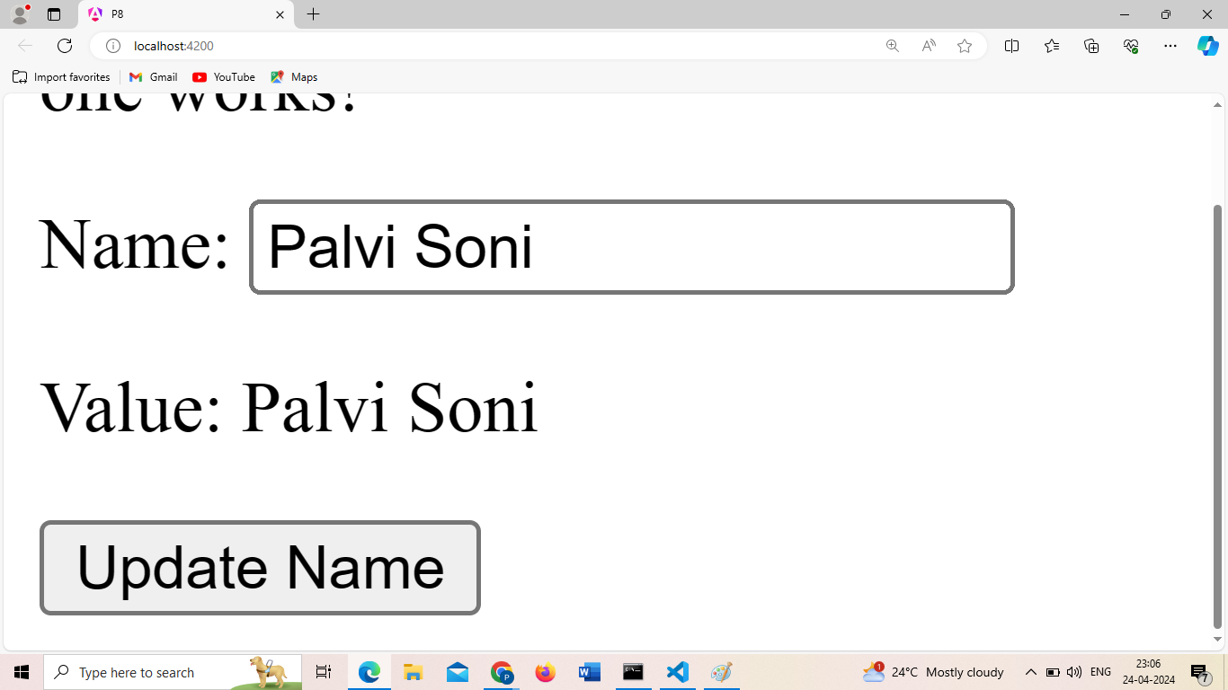

Slide 21
Weekly Activity 13- Apply a set of validations on the forms
a)Template Driven
b)Reactive Forms

Slide 22
Pipes
Use pipes to transform strings, currency amounts, dates, and other data for display. Pipes are simple functions to use in template expressions to accept an input value and return a transformed value. Pipes are useful because you can use them throughout your application, while only declaring each pipe once. For example, you would use a pipe to show a date as April 15, 1988 rather than the raw string format.

Slide 23
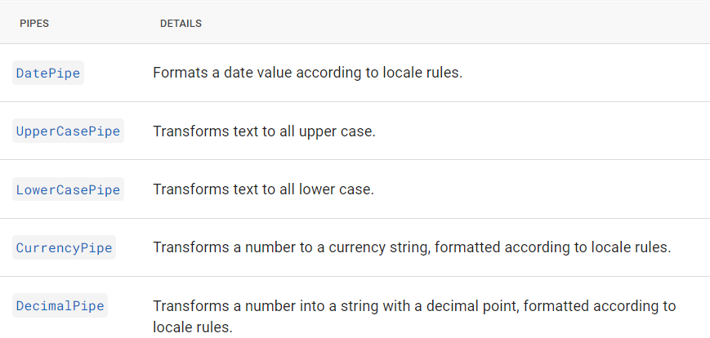

Slide 24
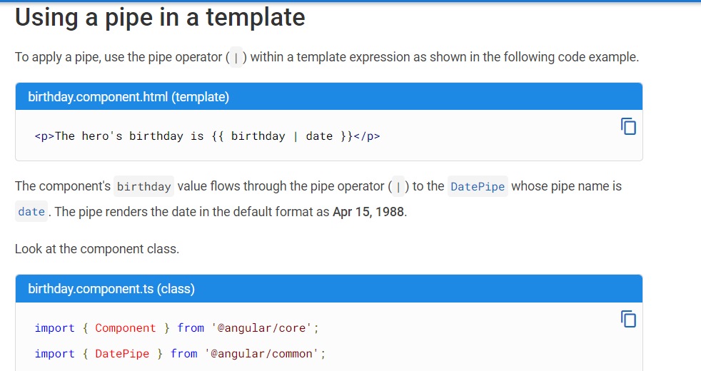

Slide 25
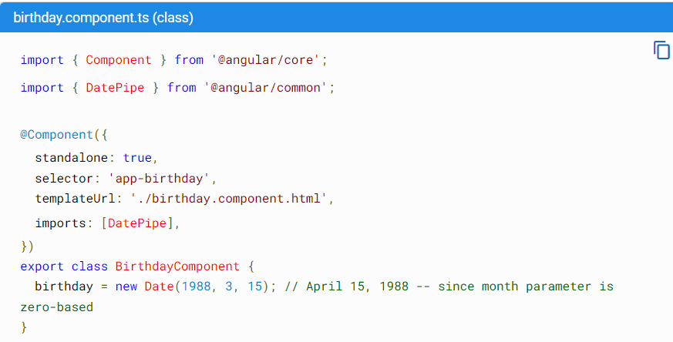

Slide 26
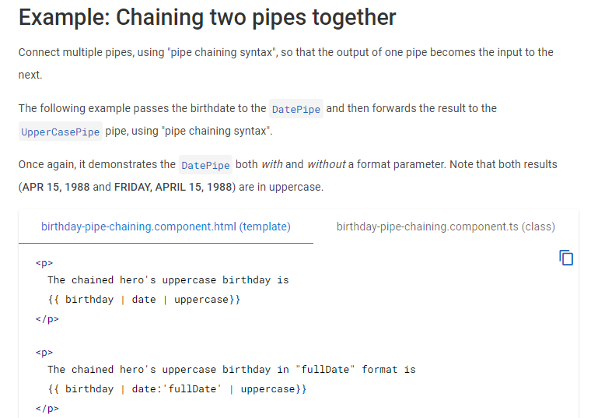

Slide 27
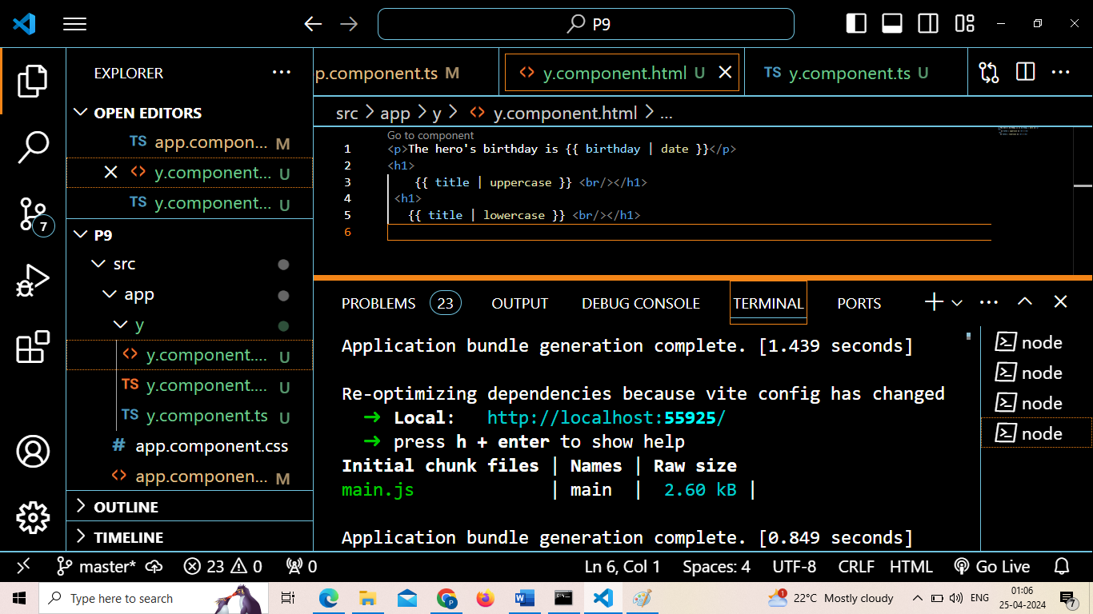
More Examples of Pipes

Slide 28
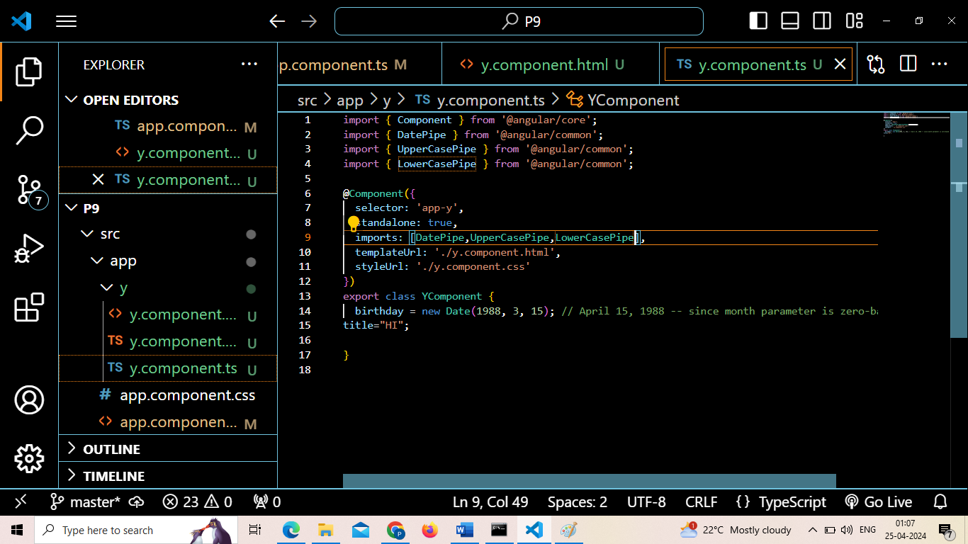

Slide 29
Services and Dependency Injection
"Dependency Injection (DI) is a design pattern to provide components with the services or other dependencies they need". Components delegate tasks to services, we can inject a service into a component, giving the component access to that service class. To make any service injectable into the component, use the @Injectable() decorator inside the service class and provide the metadata that allows Angular to inject it as a dependency in a component.
Open terminal create services there by using following command
Ng g s DataService (here dataservice is the name of the service that you want to create)
Open ts file of service file, then add one function and corresponding constructor.

Slide 30
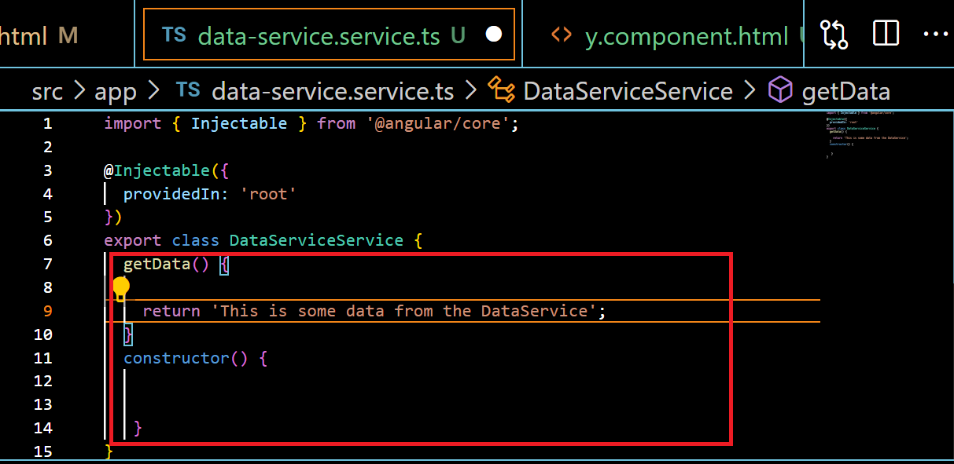

Slide 31
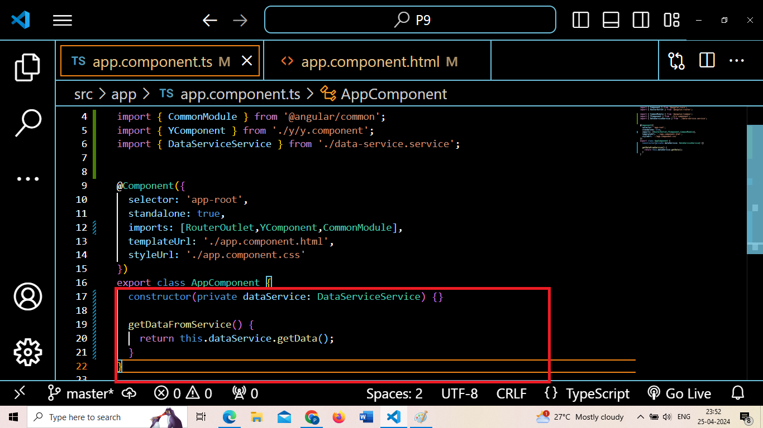
Now open app.component.ts and made changes

Slide 32
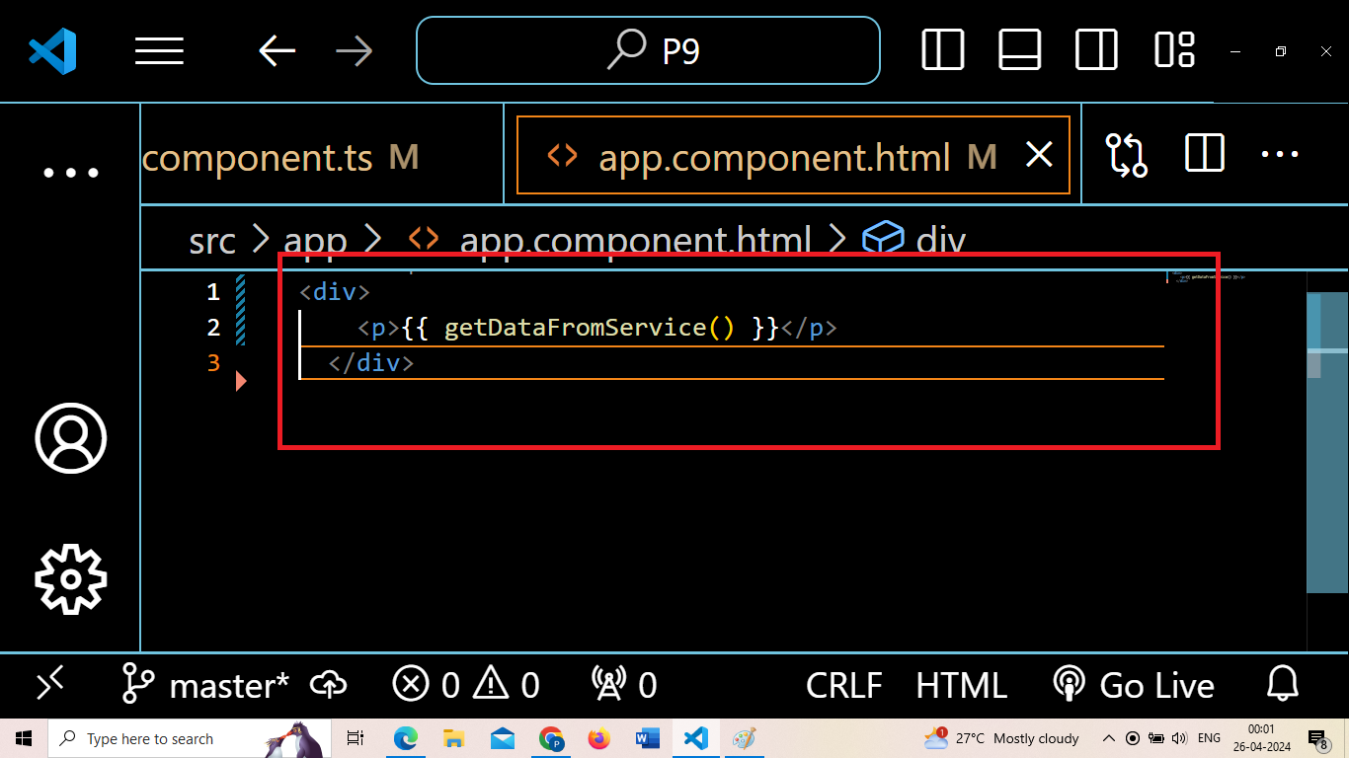
Open app.component.html

Slide 33
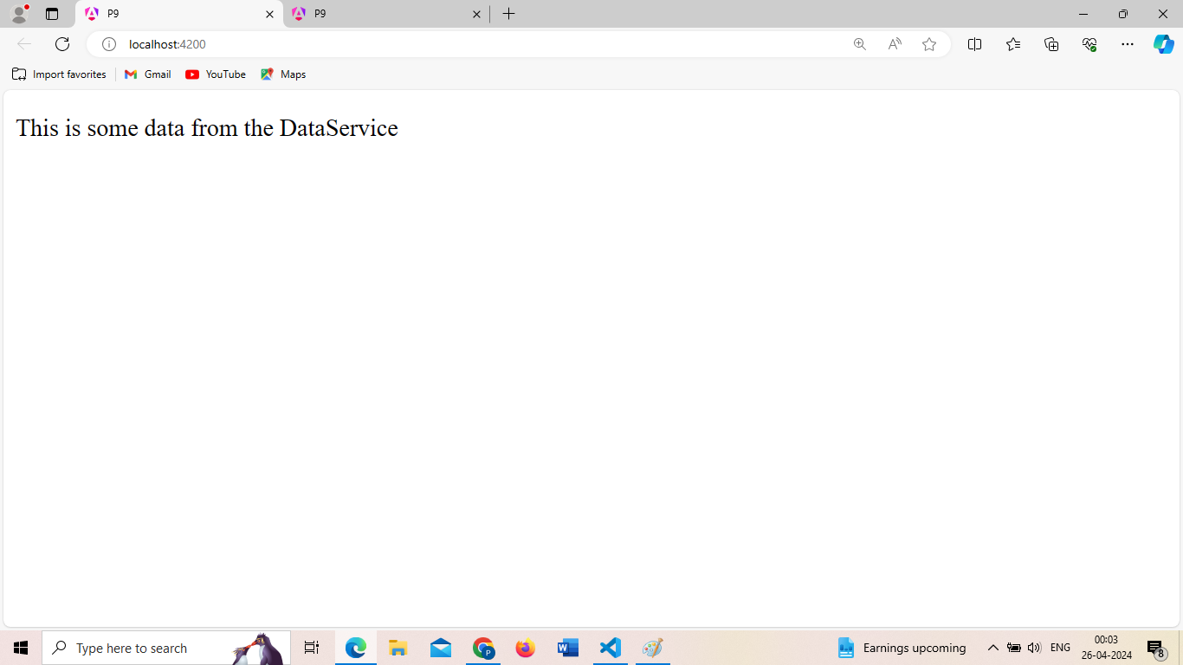
Output

Slide 34
HTTP REQUESTS
In Angular, HTTP requests are used to communicate with servers to fetch or send data. This is crucial for building dynamic web applications where data needs to be retrieved from or sent to a server.
Here's a breakdown of HTTP requests in Angular:
HttpClient Module:
Angular provides a built-in module called HttpClientModule, which offers a powerful API to perform HTTP requests. This module is part of @angular/common/http.
HttpClient Service:
The HttpClient service is the primary way to make HTTP requests in Angular applications. It provides methods for all standard HTTP operations like GET, POST, PUT, DELETE, etc.
Making Requests:
You can use the HttpClient service to make HTTP requests to external APIs or backend servers

Slide 35
Making Request
import { HttpClient } from '@angular/common/http';
constructor(private http: HttpClient) {}
this.http.get('/api/data').subscribe(data => {
console.log(data);
});

Slide 36
Handling Responses
this.http.get('/api/data').subscribe(
data => {
console.log('Data received:', data);
},
error => {
console.error('Error:', error);
}
);

Slide 37
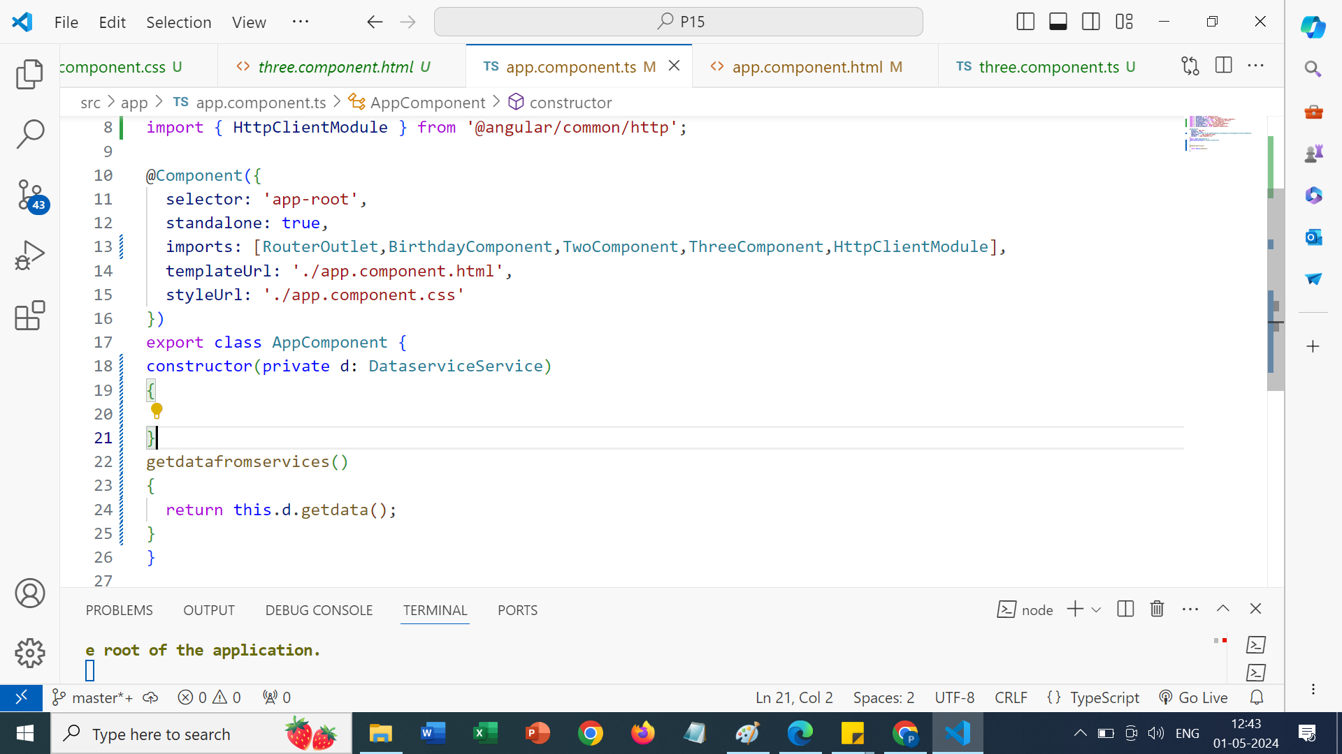

Slide 38
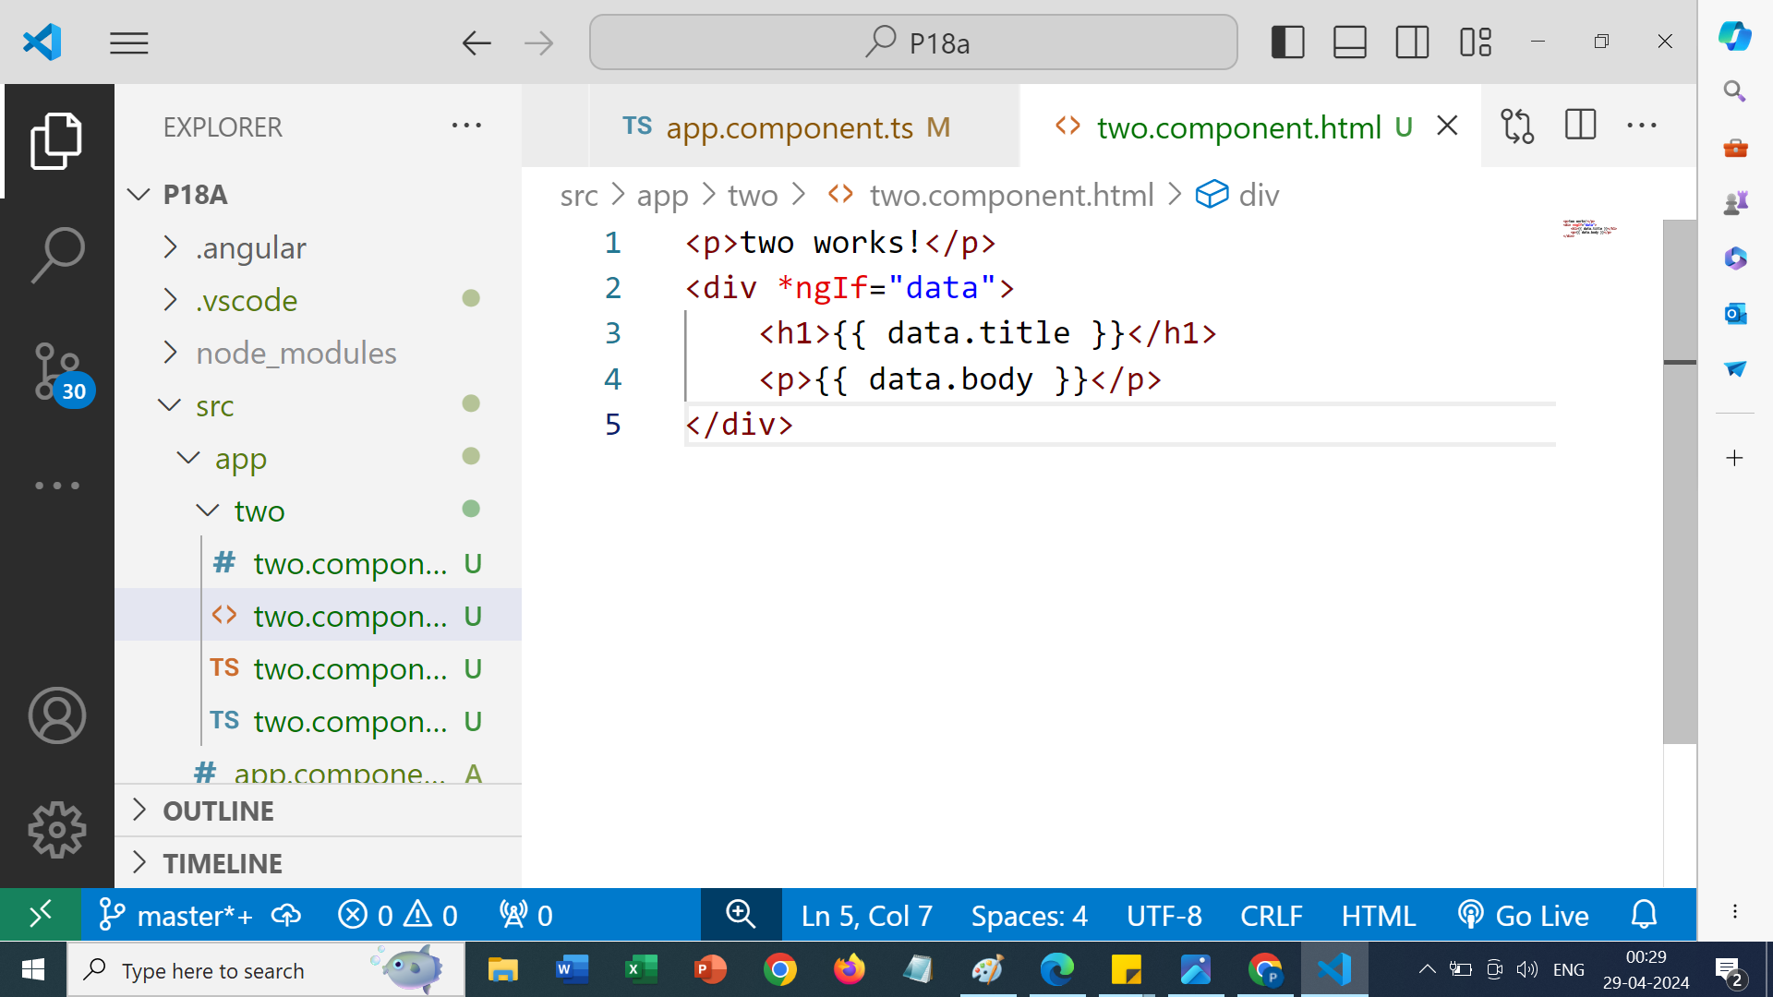

Slide 39
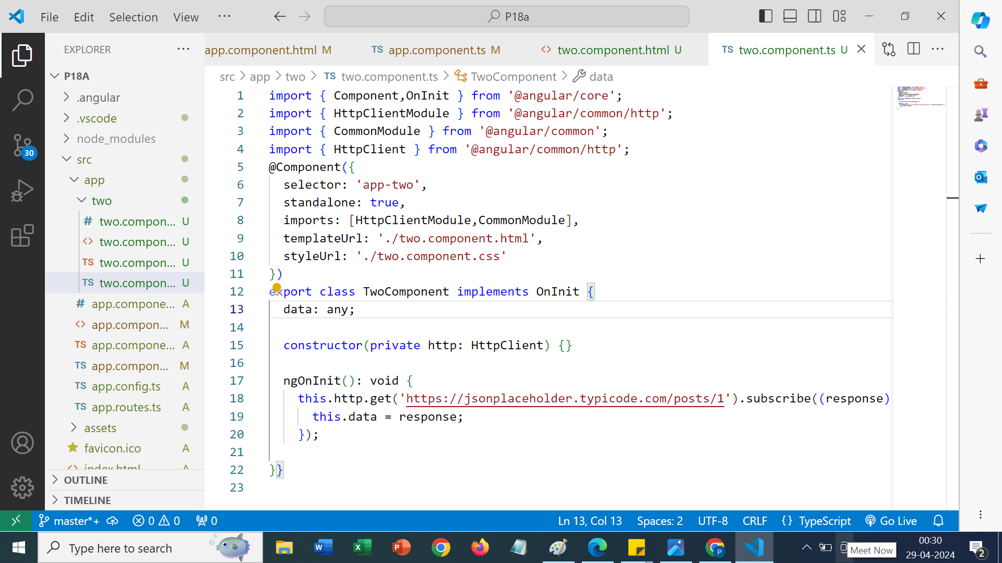

Slide 40
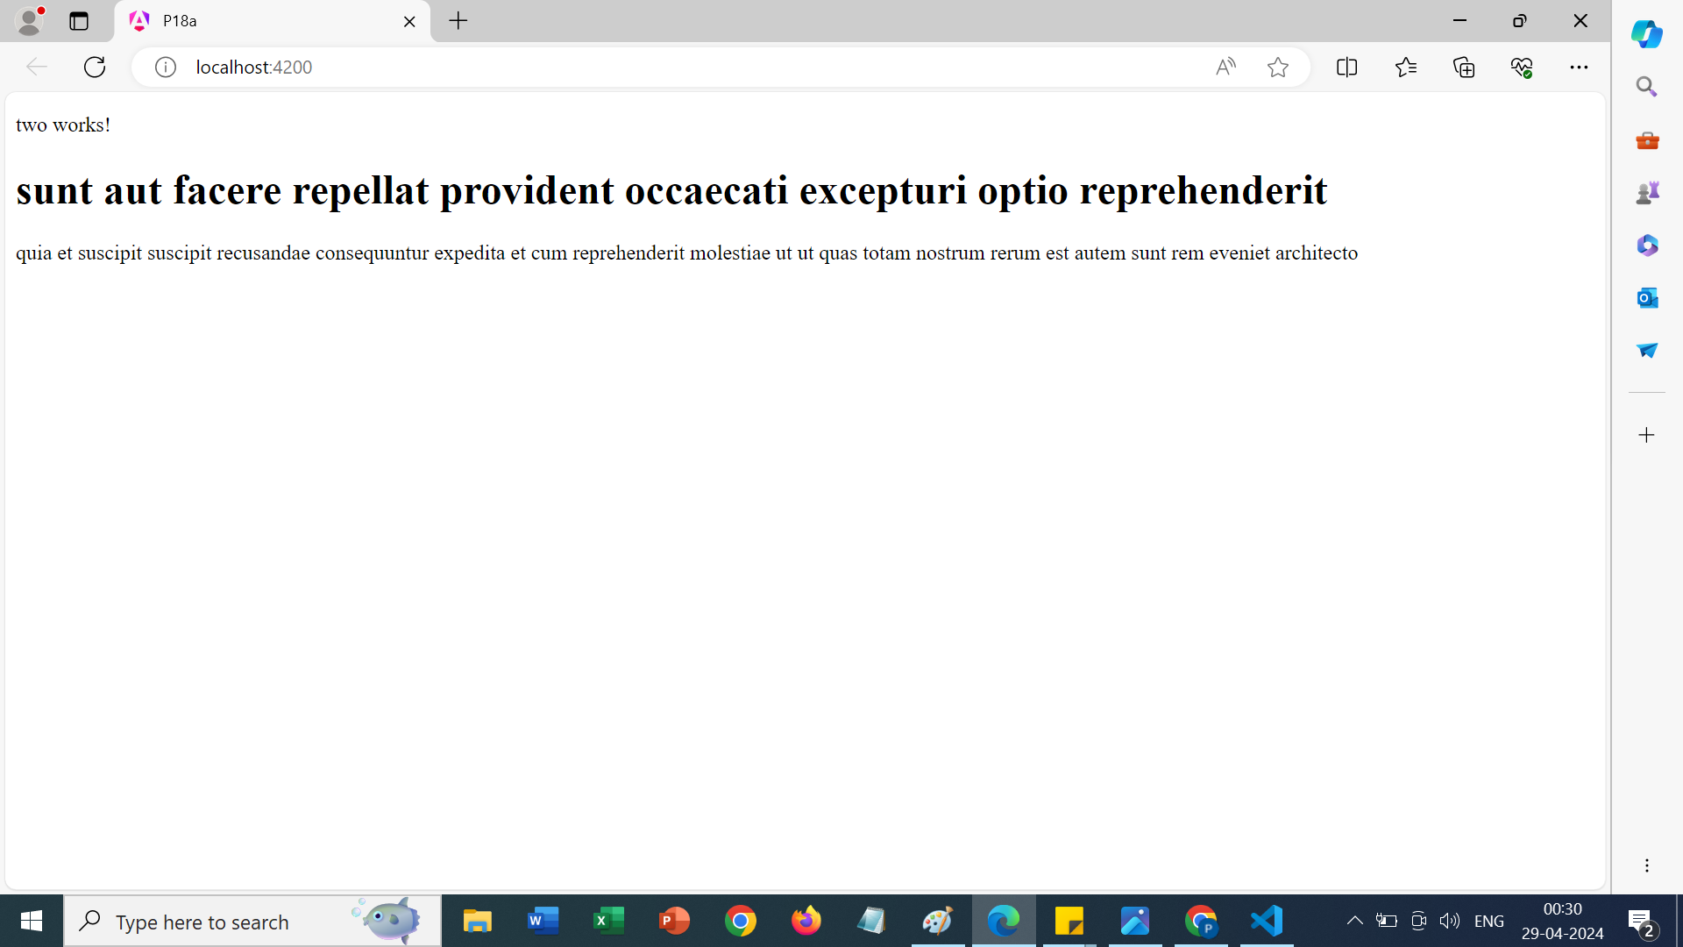
Output

Slide 41
REST API IN ANGULAR
"A service in Angular acts as a reusable data access point and is written using a Typescript class." In real-world applications, data accessed from external sources is required in multiple components. We need a single, reusable data access point, and service serves this purpose. By defining such processing tasks in an injectable service class, we make those tasks available to any component.Representational State Transfer (REST) is a software architecture that imposes conditions on how an API should work. REST was initially created as a guideline to manage communication on a complex network like the internet.

Slide 42
Steps of fetching data from a REST API in Angular 17
Step 1- Create a new project
Ng new Project123
After creating new project, you have to create a new component
Ng g c new(here new is the name of my component)

Slide 43
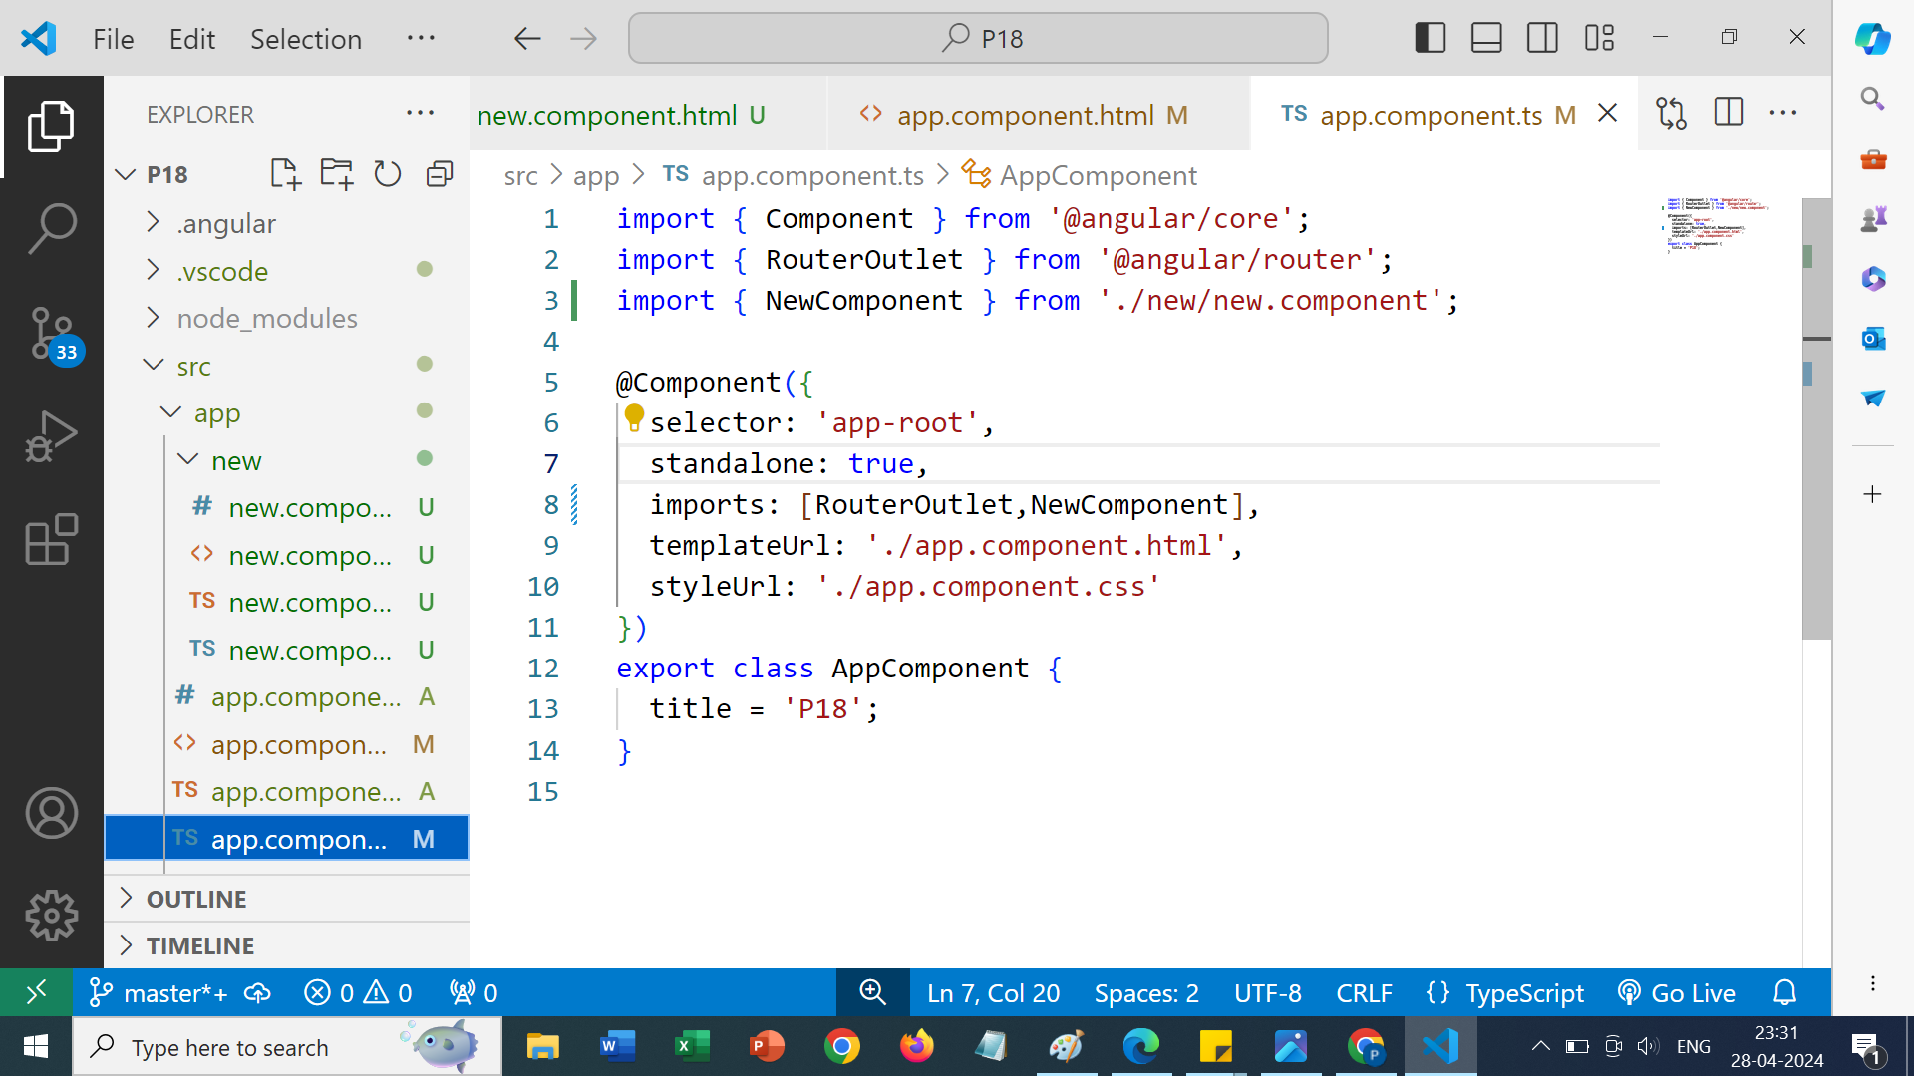
In app.component.ts, import the {newComponent} and in the imports as well

Slide 44
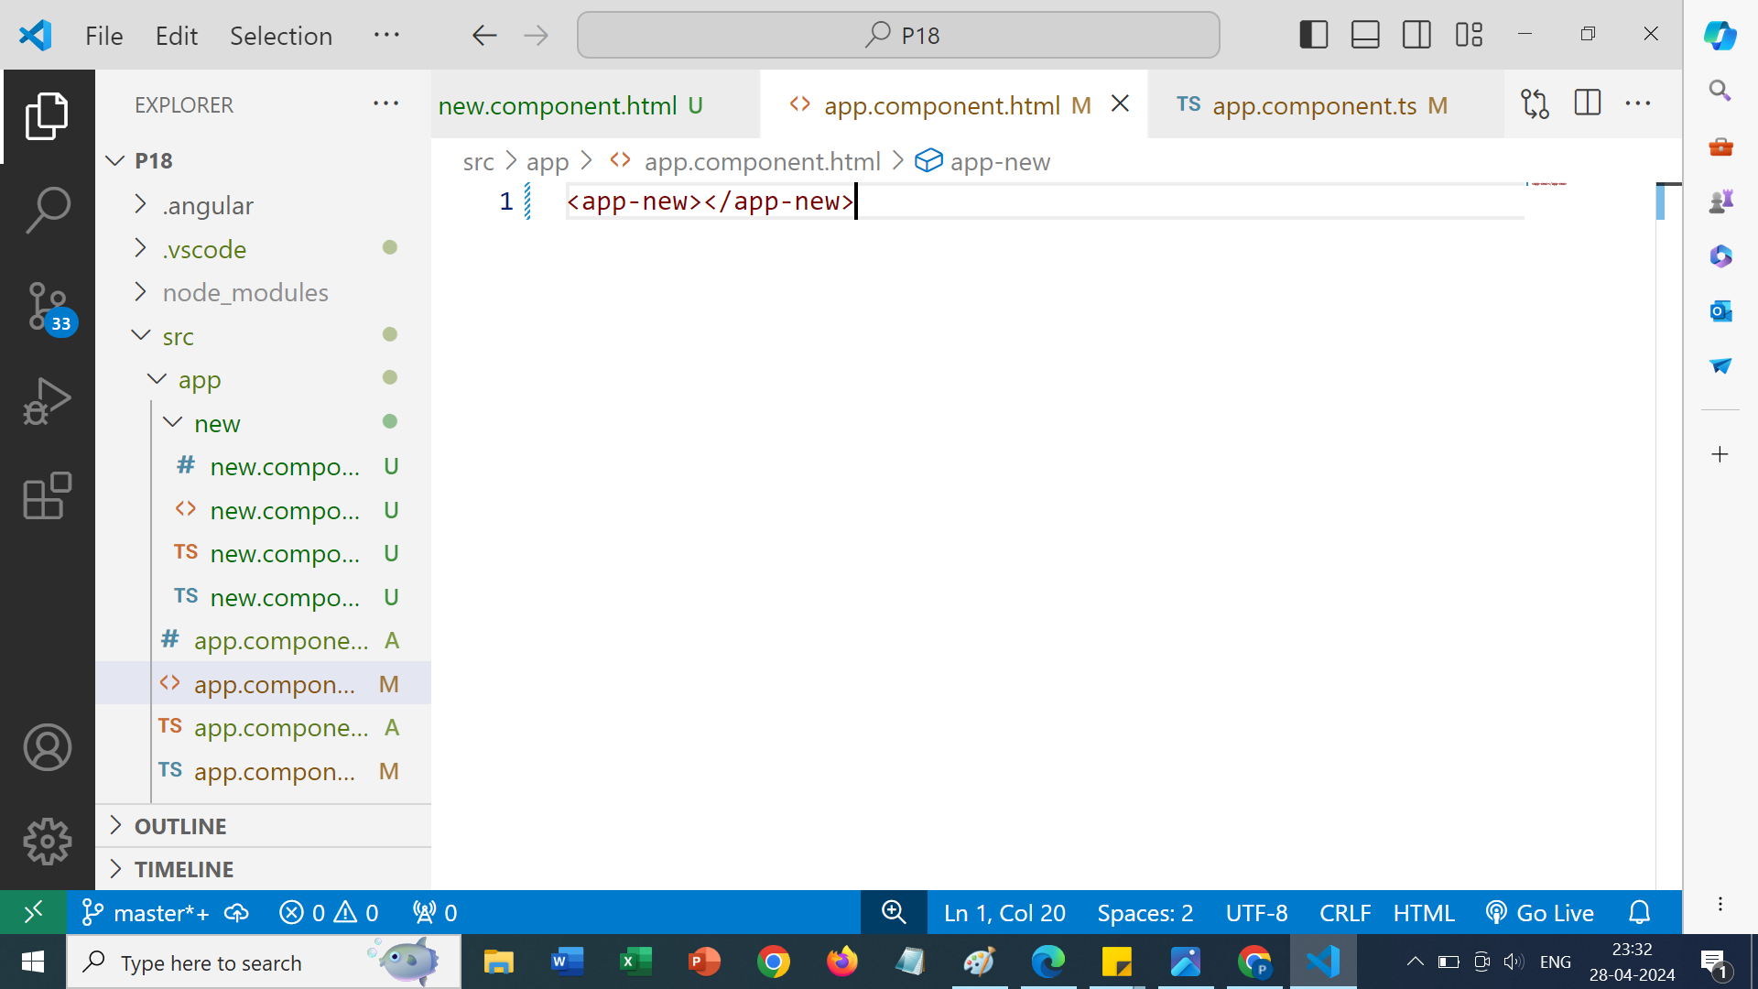
In app.component.html, write the following

Slide 45
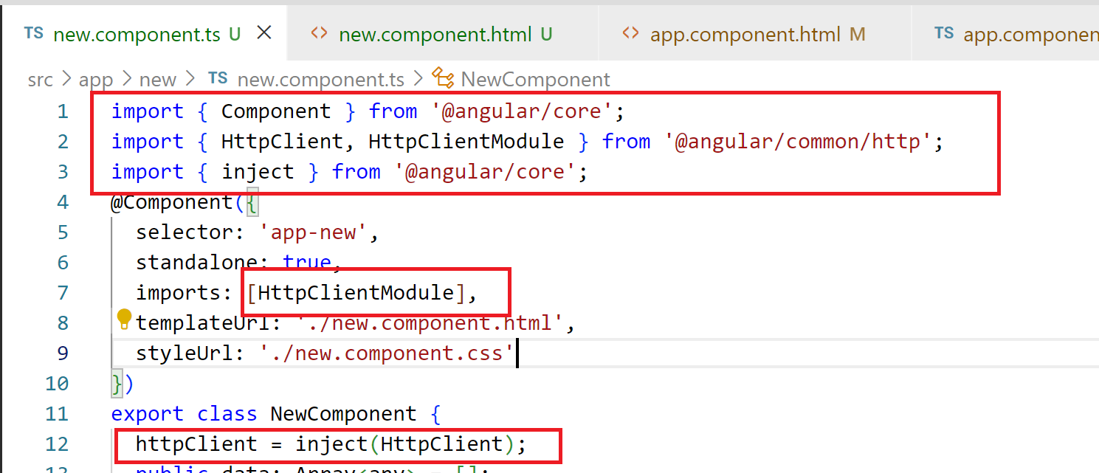
In your created component ts file make the following additions

Slide 46
Meaning
Component: This imports the Component decorator from Angular core, which is used to define Angular components.
HttpClient, HttpClientModule: These imports are for making HTTP requests in Angular.
HttpClient is the service used to make requests, and HttpClientModule is the module that provides the service.

Slide 47
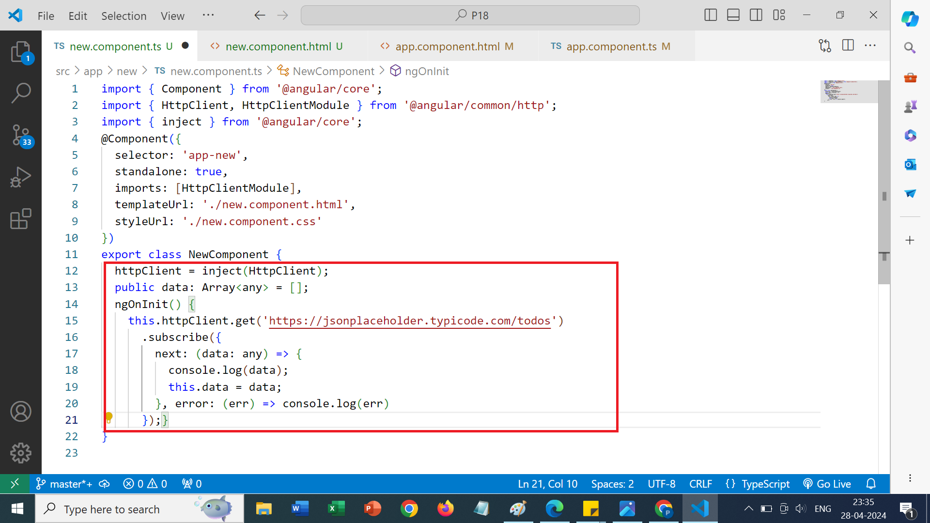

Slide 48
Explanation
httpClient = inject(HttpClient);: This line tries to use inject to get an instance of HttpClient.
public data: Array<any> = [];: Declares a public property data as an array of any type and initializes it as an empty array.
ngOnInit() { ... }: This is a lifecycle hook provided by Angular. It is called after Angular has initialized all data-bound properties of a directive. Here, it's being used to make an HTTP request to fetch data from the API endpoint https://jsonplaceholder.typicode.com/todos. The response data is logged to the console, and then assigned to the data property of the component.

Slide 49
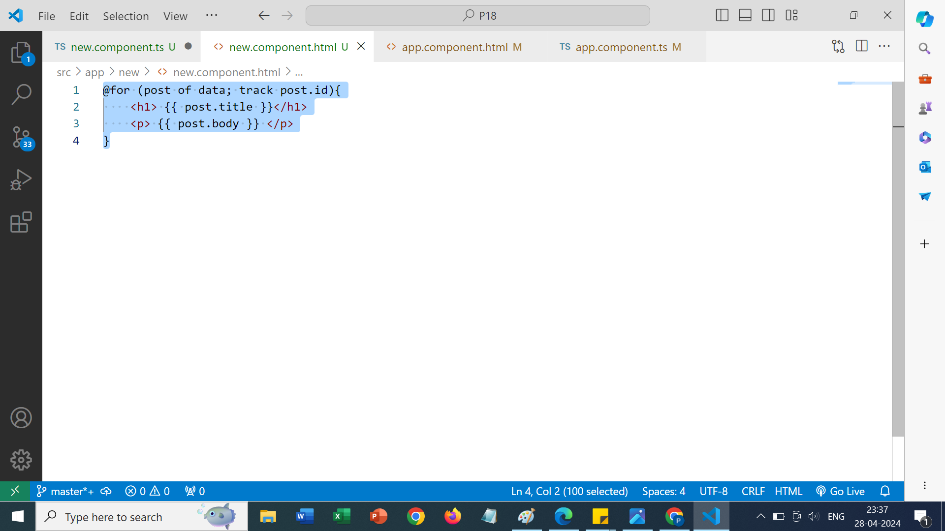
Open new.component.html

Slide 50
Explanation
*ngFor: This is Angular's structural directive for iterating over a collection. The asterisk (*) signifies that it's a structural directive, meaning it can change the structure of the DOM.
let post of data: This part declares a local variable post that represents each item in the data array.
trackBy: trackById: This is an optional parameter that you can use with ngFor to improve performance when the array is modified. It helps Angular to identify items in the array efficiently. trackById is a function defined in the component class that returns a unique identifier for each item.

